Slide 1
Encrypted Peer - Peer File System
Aayush Jannumahanti (aayushj1@umbc.edu) - FK32171
SreeVikas Edukulla (sedukul1@umbc.edu) - PY32577
Varshitha Palakurthi (vpalaku1@umbc.edu) - FA17137
Hanumantha Rao Somaraju (da16976@umbc.edu) - DA16976

Slide 2
Features
Multi threading
Concurrency
AES Encryption
Authorization

Slide 3
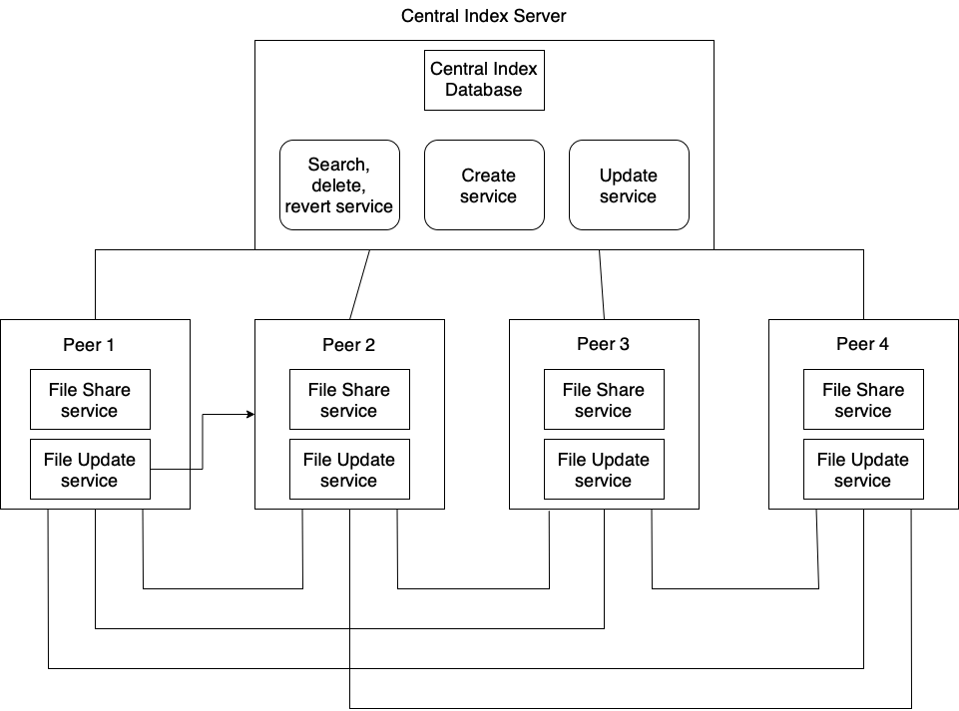
Architecture

Slide 4
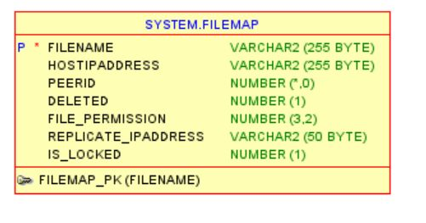

Database Schema

Slide 5
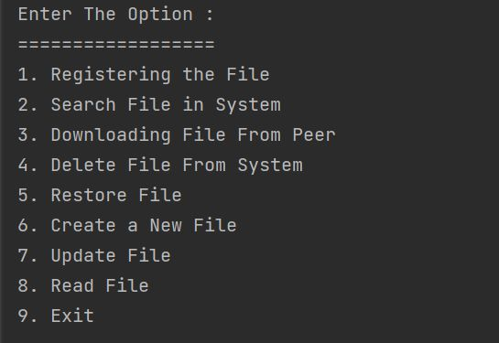
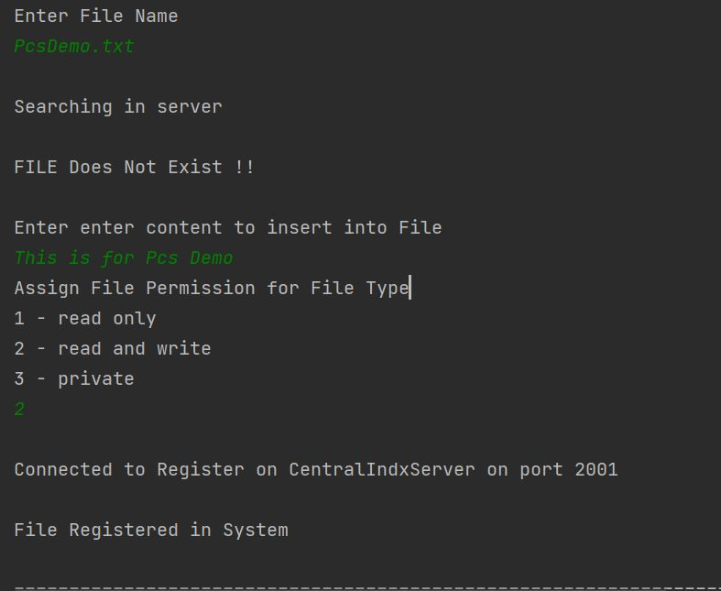
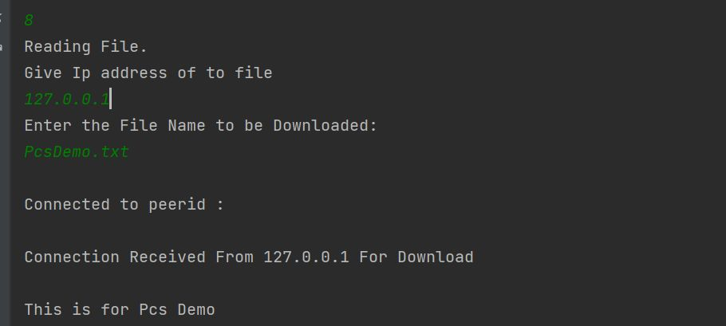
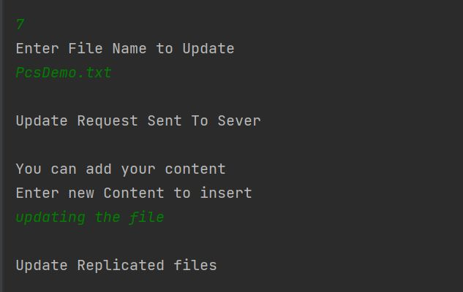
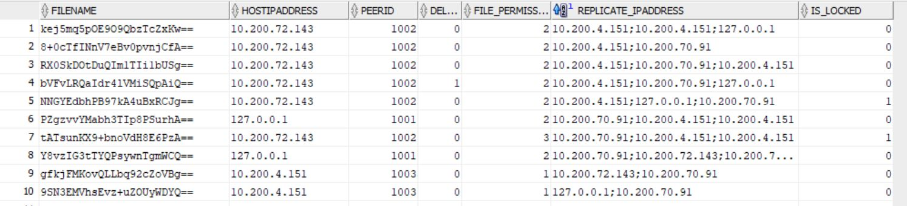

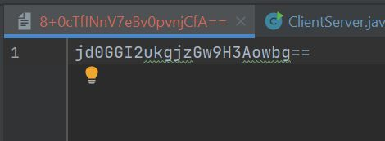
Results

Slide 6
Benchmark Findings
We have tested for 1000 request for creation, the response time for them is 35 Seconds
We have tested for 1000 request for file read, the response time for them is 33 Seconds
We have tested for 1000 request for file update, the response time for them it is approximately 29 Seconds

Slide 7
Future Enhancements
This project can be further improved to support other types of files apart from txt files.
We can create a proper GUI for CRUD operations.
Automatic registration of all the files in the peer model can be implemented.

